Slide 1









WORKSHOPS
Build a Retrieval Augmented Generation (RAG) Application With LlamaIndex
Zero Shot Labs x San Francisco AI User Group
Daryle Serrant
Data Scientist & ML Consultant
byteSolid Solutions

Slide 2


During this workshop you will…
Learn core concepts of LlamaIndex
Create a RAG application
Learn how to use LlamaIndex for integrating data in LLM applications
Notes:
Build Powerful LLM Application with LlamaIndex
By the end of this Workshop, you will:
Learn Core Concepts of LlamaIndex
Create an Open-AI LLamaIndex-powered LLM application
Learn how to use LlamaIndex for ingesting, structuring, retrieving and integrating data in LLM applications

Slide 3
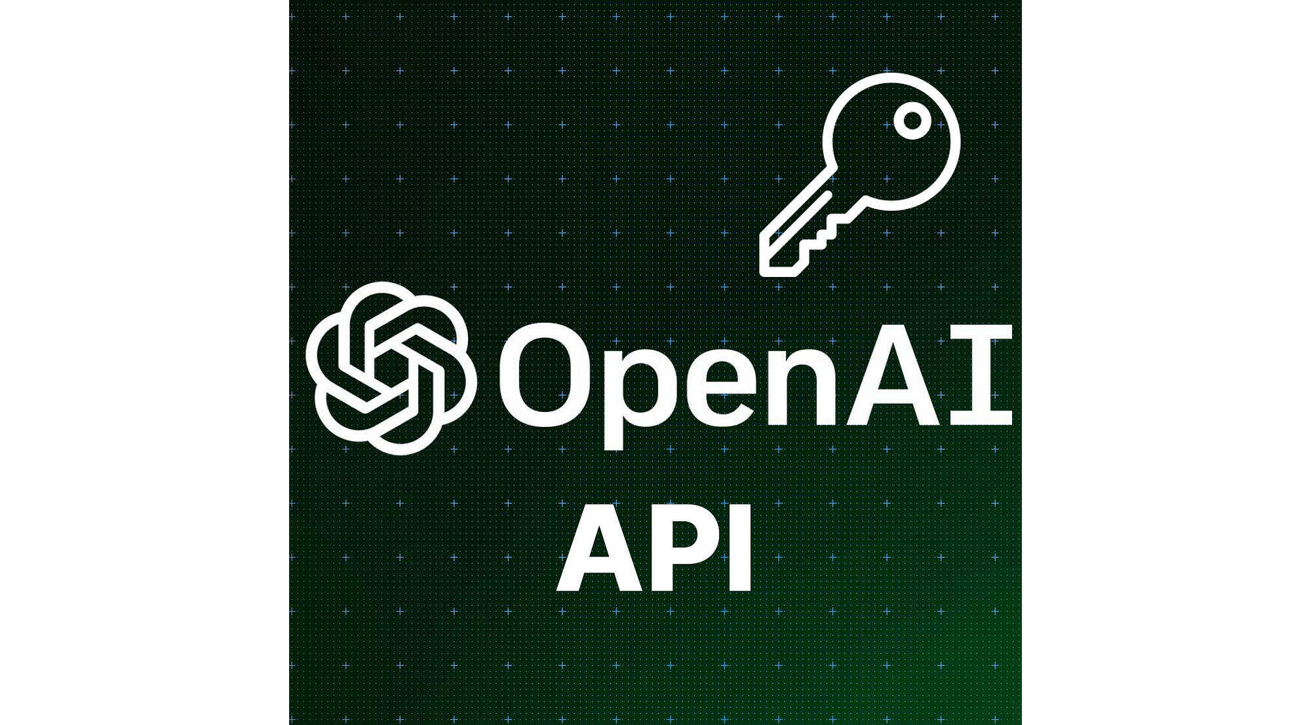

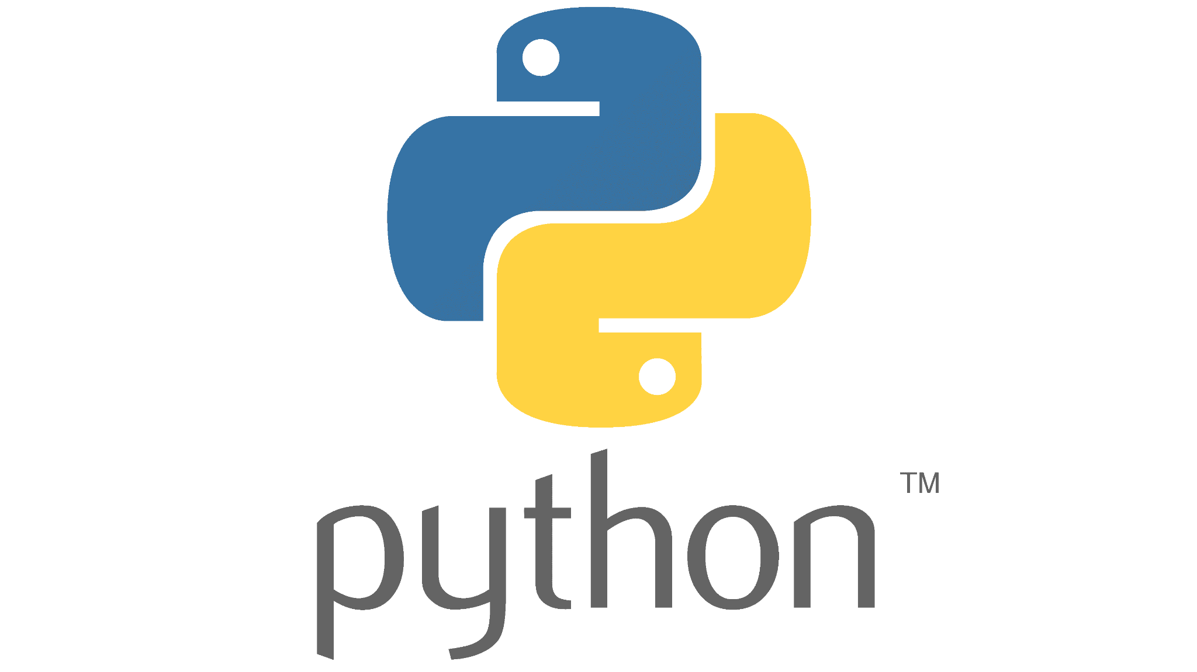
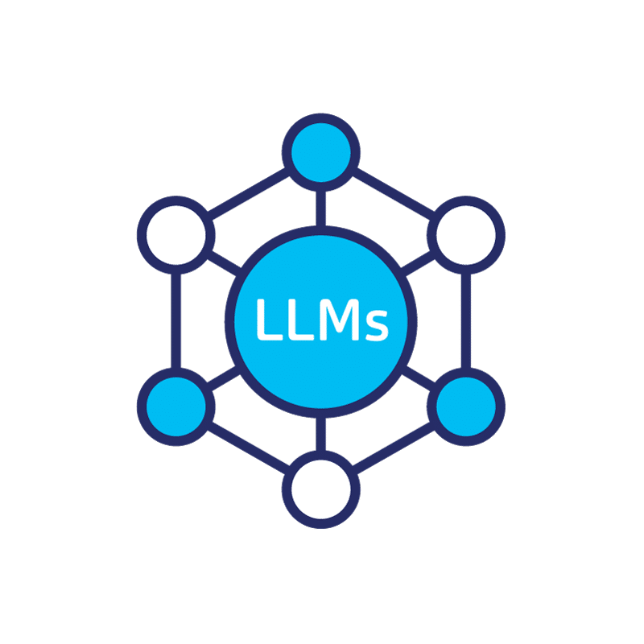
Prerequisites
1
OpenAI API Key
2
Basic familiarity with Python and Google Colab
3
Basic familiarity with Prompting / Large Language Models (LLMs)

Slide 4
Table of Contents / Agenda
1
Tech Overview [20 Minutes]
2
Hands-on Practice [20 Minutes]
3
Final Quiz

Slide 5


Tech Overview

Slide 6
What is LlamaIndex?
A multi-step tool that assists with integrating data with LLMs
Organizes data into a searchable knowledge base
APIs, databases, PDFs, etc.
Makes diverse data sources easily accessible
Notes:
What is LlamaIndex?
LlamaIndex is a multi-step tool that assists in the stages of integrating data with LLMs
Organizes your data into a searchable knowledge base
Whether your data resides in APIs, databases, or PDFs, LlamaIndex simplifies integration, making diverse data sources easily accessible

Slide 7
Stages of Data Integration
Ingest Data: Load data into the system
Structure Data: Format data in a way the LLM can understand
Retrieve Data: Find the relevant data on demand
Integrate Data: Make data meldable for various applications
Notes:
What is LlamaIndex?
LlamaIndex is a multi-step tool that assists in the stages of integrating data with LLMs
Ingesting Data: getting data from source into the system
Structuring Data: organizing data into a way for the LLM to understand
Retrieving Data: finding the relevant data when needed
Integrating Data: making data meldable for various applications

Slide 8
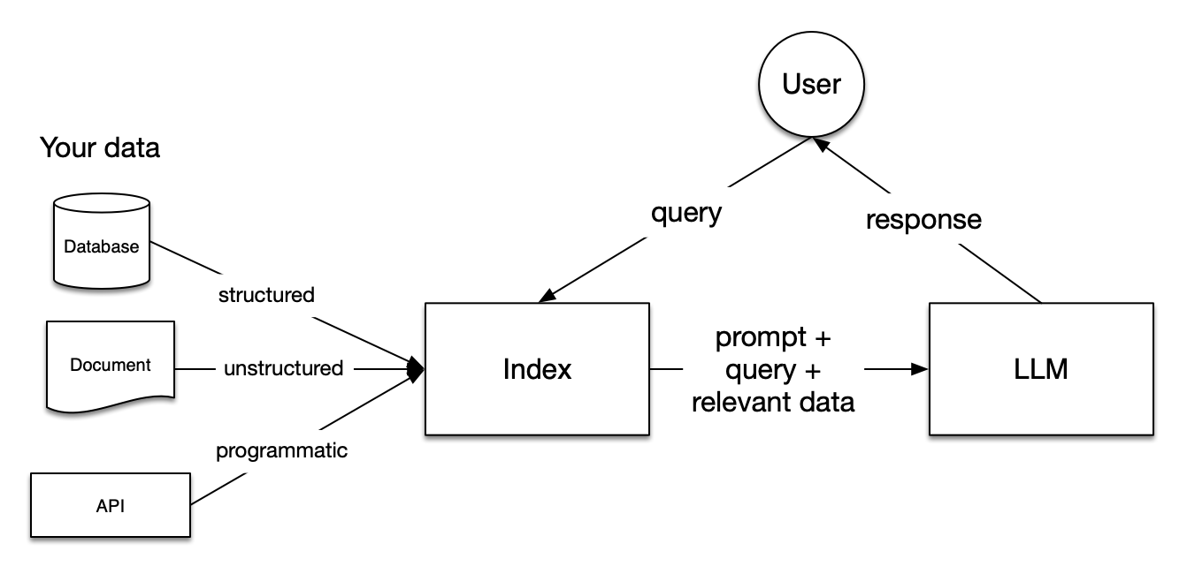
RAG Mechanism
Ingesting
Retrieving
Structuring
Integrating
Notes:
Retrieval Augmented Generation Schema
the RAG mechanism – it's the magic that supercharges LLMs with the unique essence of your custom data. So, let's break down the key steps of the RAG workflow when using LlamaIndex.

Slide 9
Components of a RAG Application
Knowledge Base (Input): stores FAQs, manuals, and relevant documents.
Trigger/Query (Input): Initiates action (i.e customer question/request)
Task/Action (Output): System executes a task to address trigger/query.
Notes:
RAG Mechanism: Amplifying LLMs with LlamaIndex
Components of a RAG application using LlamaIndex:
Knowledge Base (Input):
Like a library, it stores FAQs, manuals, and relevant documents. When a question is posed, the system refers to this repository for answers.
Trigger/Query (Input):
The spark that initiates action, often a customer's question or request that prompts the system to engage.
Task/Action (Output):
After understanding the trigger or query, the system executes a task to address it. For example, answering a question or performing a requested action.

Slide 10
Why Use LlamaIndex?
Versatile Data Integration: Provides LLMs with updated and relevant knowledge and supports various data types
Efficient Data Organization: Data is structured into a searchable knowledge base
User-Friendly: Streamlines data management and accessibility in LLM applications
Notes:
Why Use LlamaIndex?
LlamaIndex help LLMs understand and process your data- allowing for more customized, accurate* and effective applications
Versatile Data Integration: Provides LLMs with your updated and relevant knowledge and supports various data types (PDFs, databases, APIs, etc…)
Efficient Data Organization: LlamaIndex structures your data into a searchable knowledge base under the hood
User-Friendly Solution: Streamlines data management and accessibility in LLM applications for specific business needs
*reducing LLM hallucinations

Slide 11
Mechanics of LlamaIndex:
Data Connectors (Readers): Ingests data from various sources and formats into a Document* representation
Data Indices: After ingestion, Data Indices organizes data for future retrieval
Engines: The LLMs allowing natural language interactions with the data
*a generic container around any data source - for instance, a PDF, an API output, or retrieved data from a database (docs.llamaindex.ai)
Notes:
The Mechanics of LlamaIndex
Data Connectors (Readers): Ingests data from various sources and formats into a Document* representation
Data Indices: After ingestion, Data Indices organizes data for future retrieval
Engines: The LLMs allowing natural language interactions with the data
*a generic container around any data source - for instance, a PDF, an API output, or retrieved data from a database (docs.llamaindex.ai)

Slide 12
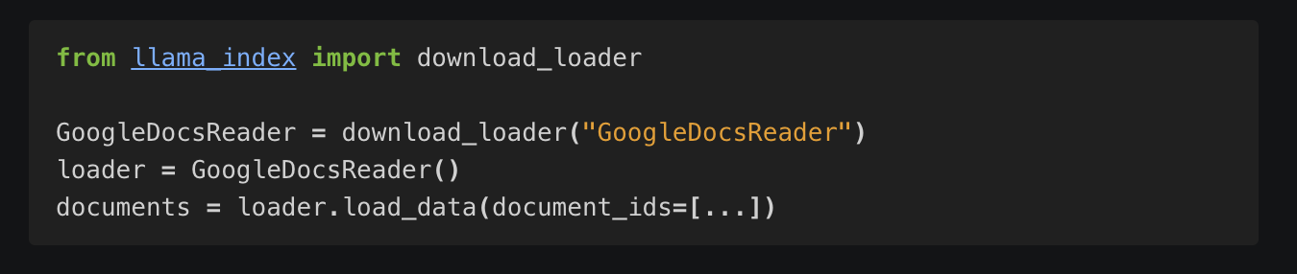
Data Connectors
Data Connectors (Readers): Ingests data from various sources and formats into a Document representation
Notes:
Data Connectors Usage Pattern
Data Connectors (Readers): Ingests data from various sources and formats into a Document representation

Slide 13
Project Overview
Build a LlamaIndex powered application using data connectors, data indices and engines
Notes:
Project Overview
Today, we will build our own LlamaIndex powered application in Python using data connectors, data indices and engines
First let’s review the Indexing Stage and the Querying Stage

Slide 14
Shaping Your Knowledge Base
Data Connectors: Ingest and format data into a document representation.
Documents/Nodes:
A Document is your container for data.
A Node is a snippet of a Document
Data Indices:
Organizes data into a retrievable format
Vector Store Index, Tree Index, etc.
Notes:
The Indexing Stage: Shaping Your Knowledge Base
Data Connectors:
Also known as Readers, ingest data from various sources and formats into a unified Document representation.
Documents/Nodes:
A Document is your container for data. A Node, is a snippet of a Document, enriched with metadata and relationships, creating precise retrieval operations.
Data Indices:
After ingestion, LlamaIndex organizes data into a retrievable format through parsing, embedding, and metadata inference, resulting in the creation of the knowledge base.

Slide 15
Fetching Relevant Data
Query Engines - Transform queries into responses with contextual references.
Chat Engines - Facilitate back-and-forths with your data
Agents - navigate tasks through dynamic action plans
We will cover Query and Chat Engines today
Notes:
The Querying Stage: Fetching Relevant Data from Your KnowledgeBase
Element to help build Q&A, chat-bots or agent-driven LLM applications:
Query Engines
Transforming natural language queries into comprehensive responses with contextual references.
Chat Engines
These engines facilitate seamless back-and-forths with your data, enhancing the user experience and engagement to a conversational level.
Agents
Equipped with a versatile toolkit, agents navigate tasks through dynamic action plans rather than rigid logic, offering adaptability and efficiency in handling diverse scenarios.
We will cover Query and Chat Engines today

Slide 16
Hands-on Demo Time!
http://tinyurl.com/ZSL-llamaindex-colab

Slide 17
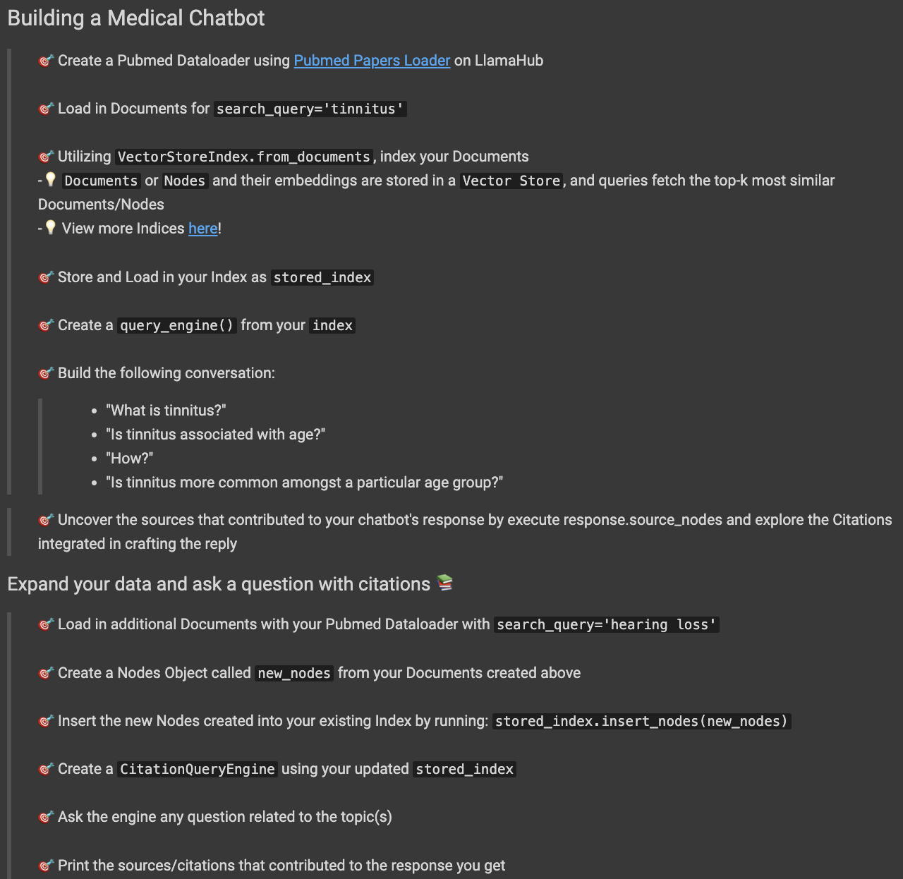

Slide 18
http://tinyurl.com/ZSL-llamaindex-colab
File > “Save a copy in Drive”
Scroll down to the last cell
Fill in your solution!

Slide 19
Final Quiz

Slide 20
Final Quiz - Q1
What is the role of data connectors (Readers) in LlamaIndex?
A. Conducting web scraping
B. Ingesting data from various sources and formats
C. Managing user interactions
D. Generating automated decisions

Slide 21
Final Quiz - Q1
What is the role of data connectors (Readers) in LlamaIndex?
A. Conducting web scraping
B. Ingesting data from various sources and formats
C. Managing user interactions
D. Generating automated decisions

Slide 22
Final Quiz - Q2
Which open-source repository hosts data connectors for seamless integration into LlamaIndex applications?
A. LlamaDocs
B. DataHub
C. LlamaHub
D. ConnectorsHub

Slide 23
Final Quiz - Q2
Which open-source repository hosts data connectors for seamless integration into LlamaIndex applications?
A. LlamaDocs
B. DataHub
C. LlamaHub
D. ConnectorsHub

Slide 24
Final Quiz - Q3
What are Nodes?
A. End-to-end conduits for querying data
B. Data connectors facilitating ingestion
C. Granular data entities representing "chunks" of source Documents
D. Automated decision-makers interacting with a toolkit

Slide 25
Final Quiz - Q3
What are Nodes?
A. End-to-end conduits for querying data
B. Data connectors facilitating ingestion
C. Granular data entities representing "chunks" of source Documents
D. Automated decision-makers interacting with a toolkit

Slide 26
Final Quiz - Q4
What is the primary purpose of NodeParser classes in LlamaIndex?
A. Conducting web scraping
B. Transforming Documents into Nodes
C. Orchestrating data retrieval across multiple knowledge bases
D. Generating automated decisions

Slide 27
Final Quiz - Q4
What is the primary purpose of NodeParser classes in LlamaIndex?
A. Conducting web scraping
B. Transforming Documents into Nodes
C. Orchestrating data retrieval across multiple knowledge bases
D. Generating automated decisions

Slide 28
Final Quiz - Q5
What role do Nodes play beyond representing "chunks" of source Documents?
A. Orchestrating complex algorithms for data retrieval
B. Serving as primary data connectors for ingestion
C. Automatically generating summaries of source Documents
D. Carrying metadata and relationship information, contributing to a more structured and relational index

Slide 29
Final Quiz - Q5
What role do Nodes play beyond representing "chunks" of source Documents?
A. Orchestrating complex algorithms for data retrieval
B. Serving as primary data connectors for ingestion
C. Automatically generating summaries of source Documents
D. Carrying metadata and relationship information, contributing to a more structured and relational index

Slide 30
Final Quiz - Q6
How can you build an index directly from Documents using LlamaIndex?
A. Utilizing the DocumentIndexer class
B. Applying the TextExtractor for indexing
C. Leveraging the .from_documents() method
D. Employing the NodeIndexBuilder from the llama_index library

Slide 31
Final Quiz - Q6
How can you build an index directly from Documents using LlamaIndex?
A. Utilizing the DocumentIndexer class
B. Applying the TextExtractor for indexing
C. Leveraging the .from_documents() method
D. Employing the NodeIndexBuilder from the llama_index library

Slide 32
Final Quiz - Q7
What is the core purpose of LlamaIndex in your data?
A. Conducting data ingestion from various sources
B. Building structured indices over ingested data
C. Orchestrating complex algorithms for data retrieval
D. Facilitating efficient querying through natural language processing

Slide 33
Final Quiz - Q7
What is the core purpose of LlamaIndex in your data?
A. Conducting data ingestion from various sources
B. Building structured indices over ingested data
C. Orchestrating complex algorithms for data retrieval
D. Facilitating efficient querying through natural language processing

Slide 34
Final Quiz - Q8
What occurs under the hood during the indexing process in LlamaIndex?
A. Documents are converted into binary to enhance indexing
B. Node objects undergo compression for efficient storage utilization
C. Index-specific computations, such as calling an embedding model for vector store indices or an LLM for document summary indices, are performed
D. Metadata and relationships of Node objects are simplified to streamline the index structure

Slide 35
Final Quiz - Q8
What occurs under the hood during the indexing process in LlamaIndex?
A. Documents are converted into binary to enhance indexing
B. Node objects undergo compression for efficient storage utilization
C. Index-specific computations, such as calling an embedding model for vector store indices or an LLM for document summary indices, are performed
D. Metadata and relationships of Node objects are simplified to streamline the index structure

Slide 36
Final Quiz - Q9
What is the purpose of the High-Level Query API in LlamaIndex?
→query_engine = index.as_query_engine()
A. Executing the ingestion process into LLMs
B. Breaking queries into sub-questions, gathering intermediate responses, and synthesizing a final response
C. Creating embedded representations of the retrieved data
D. Compressing the index structure for storage optimization

Slide 37
Final Quiz - Q9
What is the purpose of the High-Level Query API in LlamaIndex?
→query_engine = index.as_query_engine()
A. Executing the ingestion process into LLMs
B. Breaking queries into sub-questions, gathering intermediate responses, and synthesizing a final response
C. Creating embedded representations of the retrieved data
D. Compressing the index structure for storage optimization

Slide 38
Final Quiz - Q10
What are the four overarching steps LlamaIndex takes in order?
A. Ingesting Data > Melding Data > Retrieving Data > Organizing Data
B. Ingesting Data > Structuring Data > Retrieving Data > Integrating Data
C. Ingesting Data > Loading Data > Retrieving Data > Integrating Data
D. Ingesting Data > Retrieving Data > Organizing Data > Harmonizing Data

Slide 39
Final Quiz - Q10
What are the four overarching steps LlamaIndex takes in order?
A. Ingesting Data > Melding Data > Retrieving Data > Organizing Data
B. Ingesting Data > Structuring Data > Retrieving Data > Integrating Data
C. Ingesting Data > Loading Data > Retrieving Data > Integrating Data
D. Ingesting Data > Retrieving Data > Organizing Data > Harmonizing Data

Slide 40
Wrap-up and Q&A
paul@zeroshotlabs.com

Slide 41
Thank You!
paul@zeroshotlabs.com

